Slide 1

Dine@myTime

Slide 2
OUR TEAM
Dhruv Bhavsar
170410107006
Avani Sanghvi
170410107099
Sarvesh Purohit
170410107091

Slide 3
Abstract
Our app will give the users the easiness of booking table according to their convenience, viewing menu ,order their food in advance from anywhere at any time and a Take Away facility too.
Our goal is to save our customers’ time and also to maintain social distancing by not having rush of people at restaurant . We will also display the top most pick items in the restaurant being selected by the user.

Slide 4

Introduction
As nowadays demand for restaurant food is increasing. The youngsters and elders love to go to restaurants and enjoy the food .But as we know that there is a long waiting (especially during special occasions) to acquire a table in restaurant and having the food at our table.
So, here our aim is to resolve these problems through our system or application by booking a table in any restaurant from anywhere and can also order their meal in advance. (Main motto: TIME SAVING). Also an alert message facility is provided if vacant table available before booked timings.
We will use ML concepts for recommendation of top picks through the analysis of customer’s liking history. We will also provide the view of tables so people can book tables according to their likings and privacy.
Our product is very beneficial in this COVID-19 pandemic as there won’t be waiting and rush to acquire a table in restaurant and so social distancing is followed.

Slide 5

Features for Customer Side:
Sign Up & login
Explore and search restaurant (based on location)
View and book tables
Order items from menu
Add to dish and take away
Make Payment
Offers and Promo codes
View top pick
Order history
Feedback, Review and alert
Profile Management (View account, change password and other basic details )
Forget Password
Logout

Slide 6
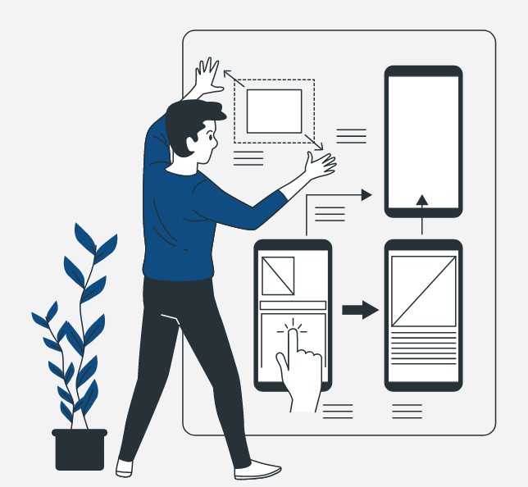
Features for Restaurant Side:
Sign Up and Login (Sign up approved by Admin)
Mange table layout
Manage Menu category & items
Mange timings and schedule ( for Online & Offline)
Manage offers & promo codes
Manage orders & Order history
Manage Payment
Reply of Feedback, Review and alert
Profile Management (View account, change password and other basic details )
Forget Password
Logout
Features for Admin Side:
Manage Customers and Restaurant
View & track activities of both customer and Restaurant
Provide Help

Slide 7
Modules of the system:
Registration/Login and Profile:
Here in this module we will manage the registration and login for customers as well as for restaurant. Users will be able to view and edit/manage their profile and see their order history.
Table Booking and Menu Ordering:
This is the main module in the system. Here the customers can view the table positions inside the restaurants and they can reserve any of the table according to their choice. The customers can do prior booking according to their time convenience. We will also display the menu provided by the restaurant and also the top picks of food items. The restaurant can also modify their restaurant’s menu and table arrangement according to the changes made in the restaurant.
Also in this module we will send notification few minutes before their booked timings and alert message to the customer if in case the vacancy of tables there. Also if any cancelation occurs then that duration will be managed for walk-in customers.

Slide 8
Take away: Here we will also provide the take away services to our customer and add to dish facility is also available. Customers can also see the order status and accordingly come and take the food ordered.
Payment: In this module we are going to design the payment system in which customer makes payment against their any type of orders or booking and same restaurant will verify the payment status of individual customer so that restaurant will make necessary arrangements . And also the customers can apply coupon code if it will be making available by restaurant.
Management System: This comes purely under the role of Admin by managing customers and restaurant account. Also providing help regarding our app working issues if needed.
Ratings: Over here the customers can provide ratings and reviews for restaurant and also see others’ reviews. The customer and restaurant can provide feedback for our app.

Slide 9

THANK YOU

